Slide 1


Introduction to Popular Culture
Sonal Jha, PhD Department of Humanities and Social Sciences

Slide 2

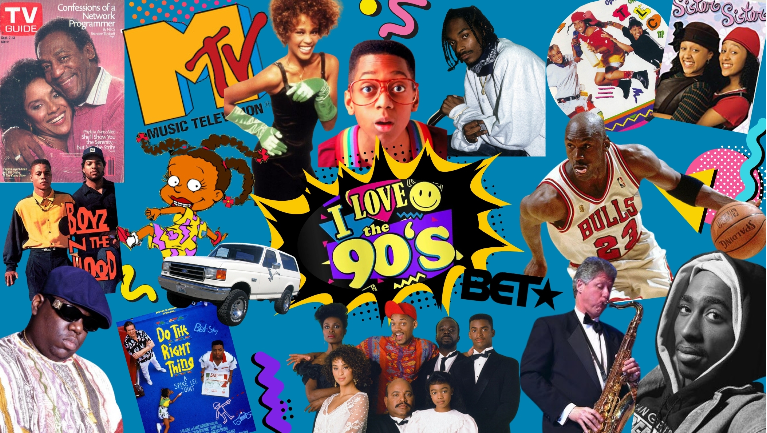
Defining Popular Culture
Popular culture refers to cultural products and trends that are widely favored or encountered by many people. It is characterized by mass production and mass consumption.
•
It stands in contrast to "elite" or "high" culture.
•
Scope includes music, film, television, fashion, cyberculture, literature, and sports.
•
It frequently defines the shared historical and social experiences of a generation.

Slide 3



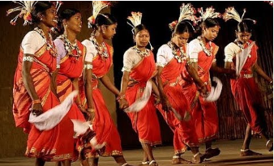
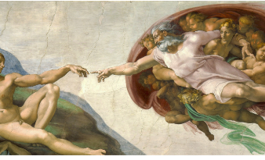
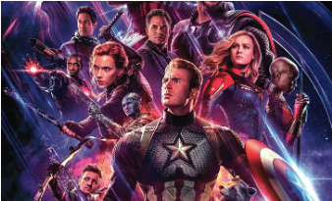
The Three Cultural Spheres
Folk Culture
High Culture
Popular Culture
Traditional, localized, and pre-industrial (e.g., Folk dances, folk tales, festivals etc.).
Elite, often expensive or restricted access (e.g., Classical literature, Ballet, Renaissance Art).
Mass-produced, commercial, and accessible to everyone (e.g., Marvel films).

Slide 4
Comparative Analysis
Feature | High Culture | Popular Culture
Creator | Individual "Genius" or Auteur | Teams, Corporations, or Industries
Audience | Small, elite, specific | Large, diverse, general
Value | Timeless, eternal ("The Classics") | Trendy, transient ("Flavor of the month")
Purpose | Art for art's sake; intellectual growth | Profit and entertainment; escapism
Consumption | Focused attention (silence in a museum) | Casual consumption (background noise)

Slide 5



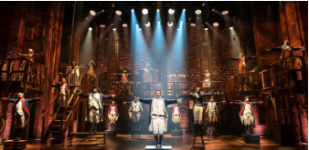
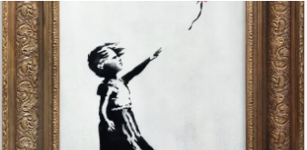
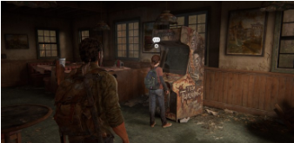
Blurring the Boundaries
In the 21st century, the distinction between High and Pop culture is increasingly permeable.
Hamilton
Banksy
Video Games
Utilizes Hip Hop (Pop) to narrate history in a Broadway setting (High).
Graffiti, once vandalism (Low), now sells at elite auctions (High).
Narratives like The Last of Us receive literary-grade critical analysis.

Slide 6

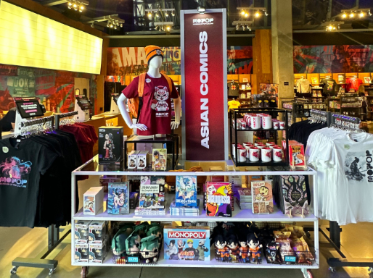
Key Characteristics
•
Mass Media: Disseminated through TV, internet, radio, and print.
•
Commercialization: Driven by profit, marketing, and merchandise.
•
Standardization: Formats are often repeatable and formulaic.
•
Transience: Trends change rapidly; popular today, gone tomorrow.

Slide 7

Mass Media & Universal Appeal
Popular culture is inherently the culture of the majority, designed to capture the largest possible audience, appeals to the lowest common denominator.
•
Quantitative Success: It relies on numbers; a film is defined as "pop culture" by its viewership.
•
Universal Appeal: To minimize alienation, it often avoids abstract complexity.
•
Themes: Focuses on universal tropes like love, heroism, and humor.

Slide 8


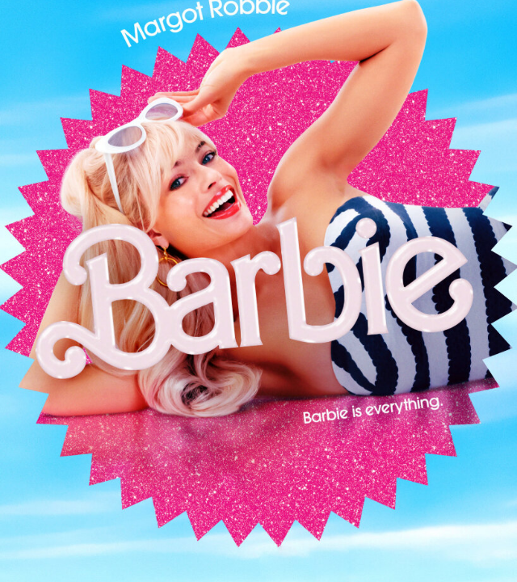
Commercialization
Unlike Folk or High Culture, Pop Culture is primarily produced for financial gain by massive global corporations (e.g., Disney, Sony).
The product often serves as a launchpad for a broader ecosystem of merchandise: toys, apparel, video games, and brand tie-ins.
Case Study: The Barbie movie functioned as a global marketing campaign for the underlying product line.

Slide 9
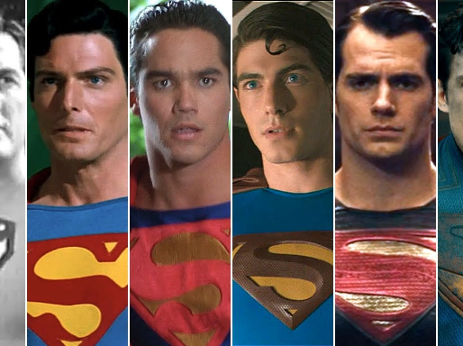
Standardization & Predictability
Formulaic Structures
Audiences derive comfort from familiarity. Sitcoms, for example, often adhere to a specific "Setup-Conflict-Resolution" arc within a fixed runtime.
Remix Culture
This structural reliance explains the prevalence of sequels, prequels, and reboots. Predictability reduces financial risk for producers, comforting for audiences.

Slide 10
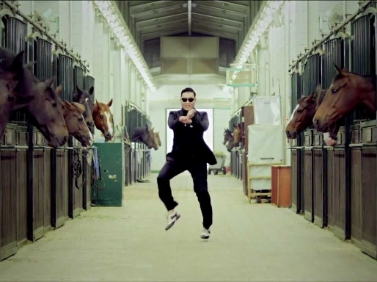
Transience
Pop culture is characterized by an obsession with the "now." Dominant trends can become obsolete with remarkable speed.
The Lifecycle of a Trend:
1.
Emergence
2.
Saturation (Mainstream)
3.
Obsolescence ("Outdated")
4.
Disappearance

